Slide 1
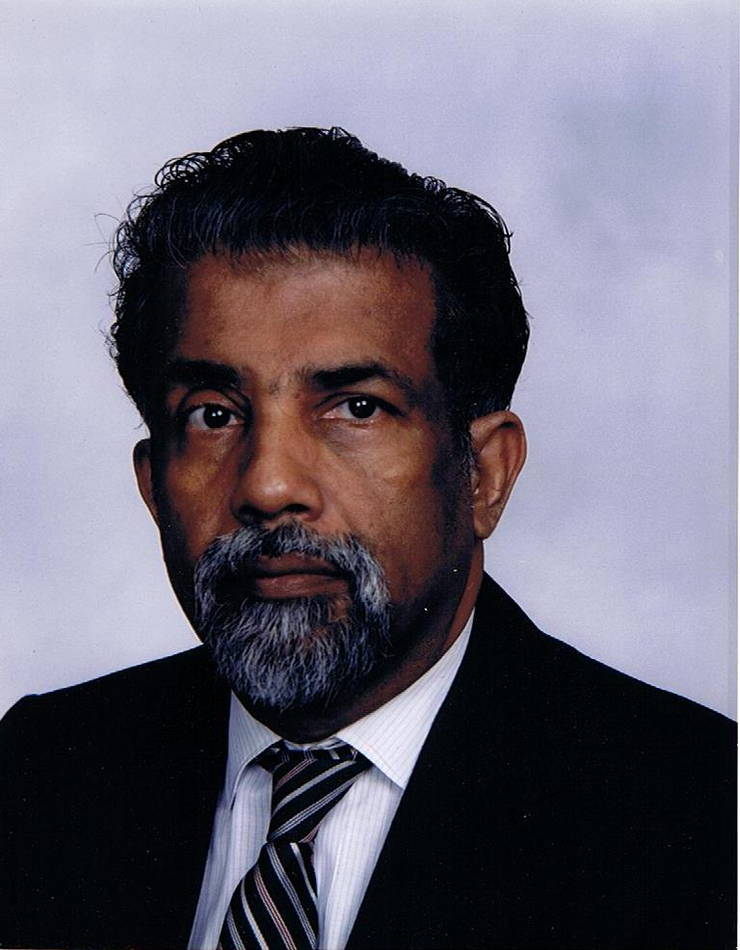
E. C. George Sudarshan
Notes:
# Name E. C. George Sudarshan # Textbook Knight, College Physics: A Strategic Approach, 2nd Edition, Chapter 27, Nuclear Fission Knight, Physics for Scientists and Engineers: A Strategic Approach with Modern Physics, 3rd Edition, Chapter 37 Knight, Physics for Scientists and Engineers: A Strategic Approach with Modern Physics, 3rd Edition, Chapter 42 # Contributors # Description E. C. George Sudarshan is a theoretical physicist born in Pallam, Kerala. He has made significant contributions such as proposing the theory of V-A WeakForce which is central to radioactive decay and nuclear fission. Controversially, he was not awarded a Nobel Prize for his work on quantum optics (Sudharshan-Glauber representation), while Glauber received recognition for it in 2005. # Sources E. C. George Sudarshan. (2018, February 20). Retrieved February 20, 2018, from https://en.wikipedia.org/wiki/E._C._George_Sudarshan # Photo http://dftuz.unizar.es/sudarshan/gsphoto.jpg

